Slide 1
Classes, IDs, Scripts, and Filepaths
Module 4

Slide 2
Classes

Slide 3
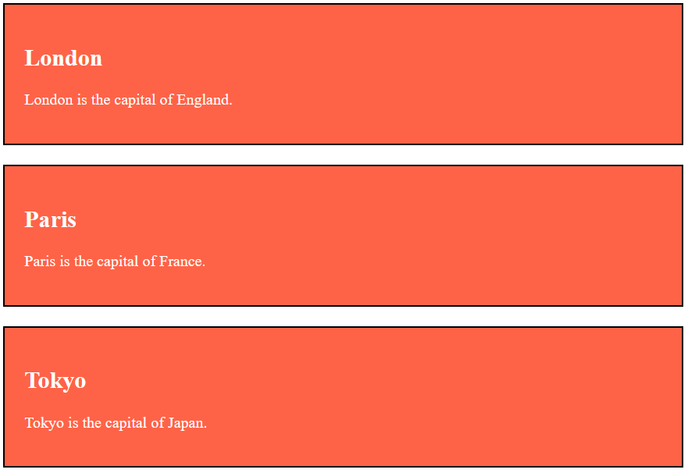
Using the class Attribute
The class attribute usually points to a class name on a Style Sheet
classes are useful for styling many sections of our HTML pages at the same time
JavaScript allows you to select elements by their class, which can be very helpful for changing large portions of the page

Slide 4
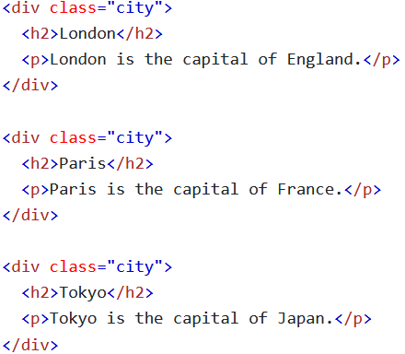
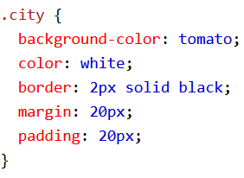
The Syntax For Class
To create a class, you write the classes name after a period
Then, you define the class’s properties inside of curly braces
For the class to take effect, you must also assign each element to that class

Slide 5

Multiple Classes
Any element can belong to multiple CSS classes
For an element to belong to multiple classes, you must put a space between the class names when you assign them

Slide 6
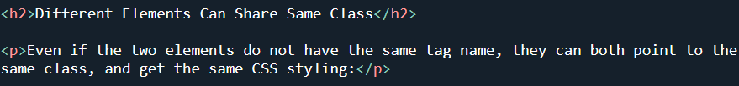
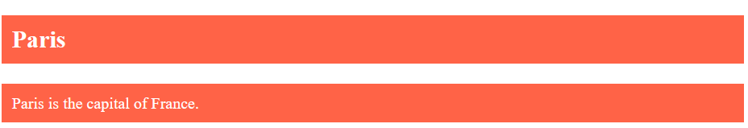
Classes Can Style Different Elements
Any element can be a member of any class
Depending on the class, some styles may not take effect

Slide 7
IDs

Slide 8
Using the id Attribute
The id attribute is a unique id for an HTML element
There can only be one of each id
IDs can be used by JavaScript to select and manipulating individual elements

Slide 9
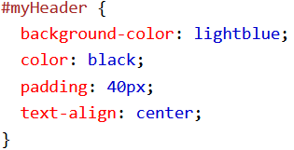

ID Syntax
To write an ID, you always begin with a hashtag followed by an id name, followed by curly braces
You must also assign the id to the element

Slide 10
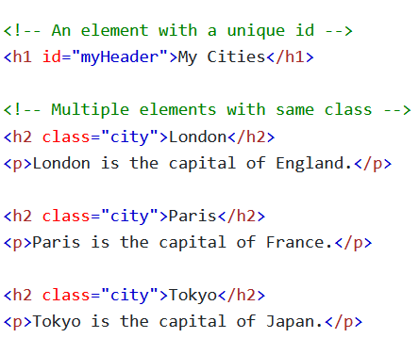
Classes vs IDs
Classes can be used for as many elements as you want
IDs can be used for a single element
Classes stop you from rewriting the same code over and over again, while IDs help you give unique elements extra flare or effects
IDs are helpful for creating bookmark links

Slide 11
HTML Iframes

Slide 12
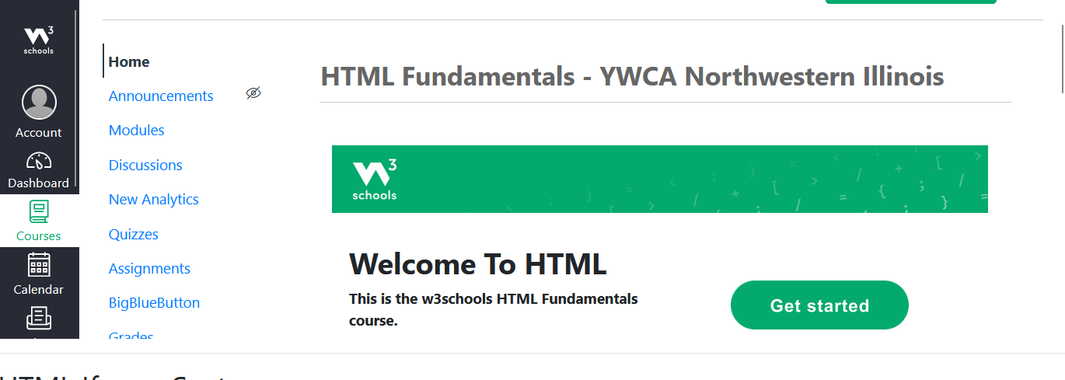

HTML Iframe Syntax
An <iframe> element creates an inline frame
Iframes are used for embedding other documents within the current HTML document
An <iframe> element must have a src attribute and should have a title attribute for accessibility
Notes:
Iframe is a conjunction for “Inline frames”, it is not related to Apple or the iPhone

Slide 13
Iframe – Width and Height
You can specify the dimensions of your <iframe> element using the width and height attributes
Alternatively, you can use the style attribute with the CSS height and width properties

Slide 14
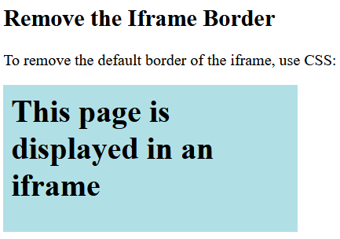
Iframe - Border
Iframes have borders by default
You can create different types of borders, or remove it entirely, using the style attribute and the CSS border property

Slide 15
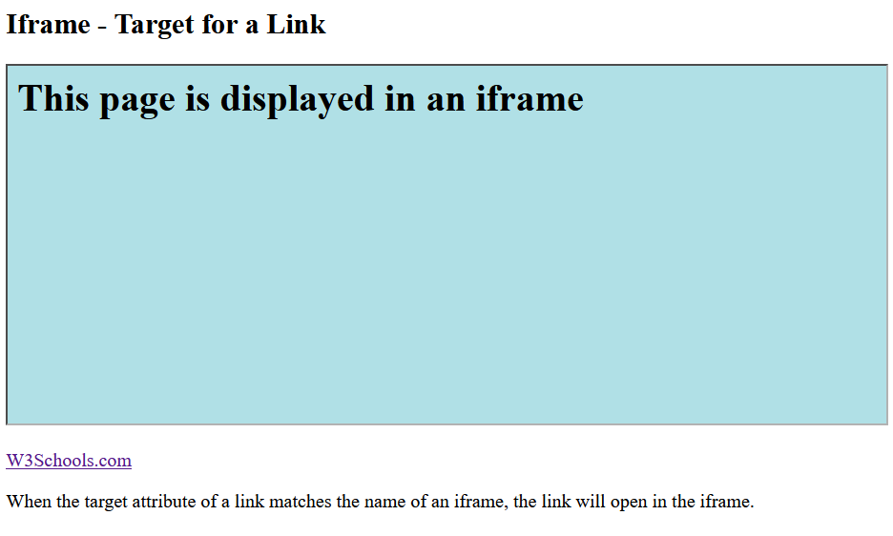
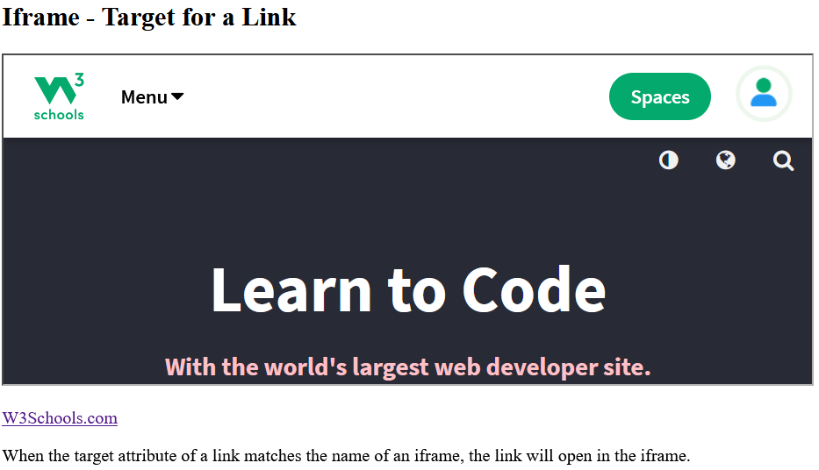

Iframe – Target for a Link
An Iframe can be the “target” for a link
To do this, the target attribute of the link must refer to the name attribute of the iframe

Slide 16
HTML JavaScript

Slide 17

The <script> Tag
The <script> tag links a client-side (browser) script to the page
The <script> tag can either contain JavaScript code between its start and end tags, or its src attribute can link entire JavaScript files
We can use JavaScript for manipulating images, validating information from forms, or dynamic content changes

Slide 18

JavaScript
Whenever you use a <script> element, it should always be the last element in the <body>
JavaScript frequently uses the document.getElementById() method to select elements

Slide 19
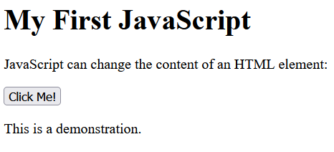
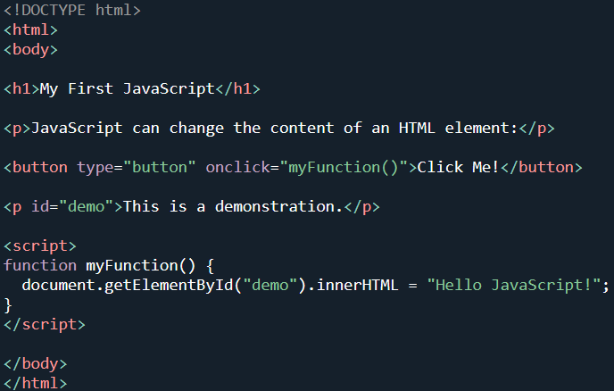
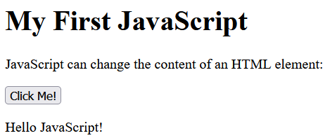
JavaScript Examples – Changing Text

Slide 20
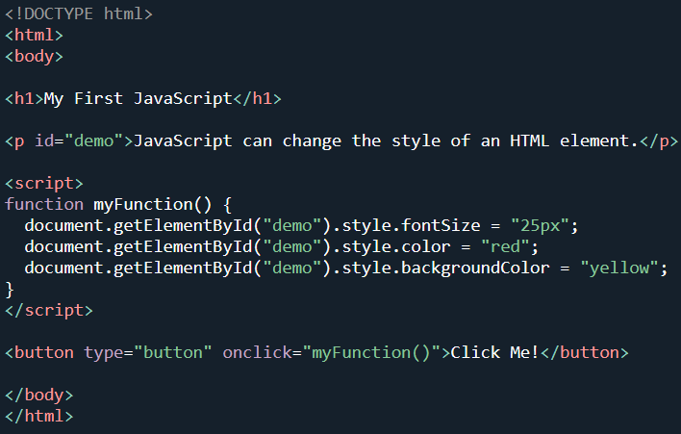
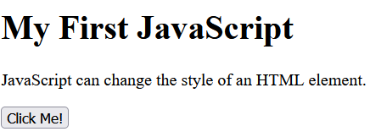
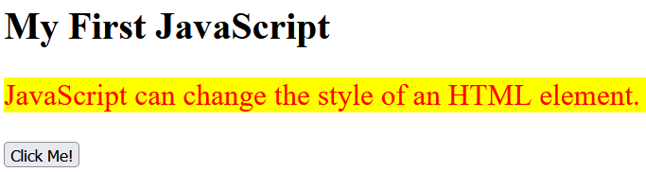
JavaScript Examples – Changing Styles

Slide 21
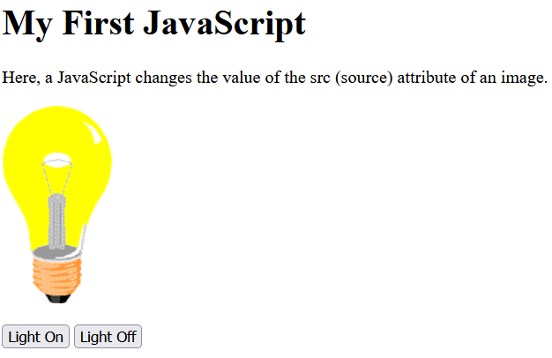
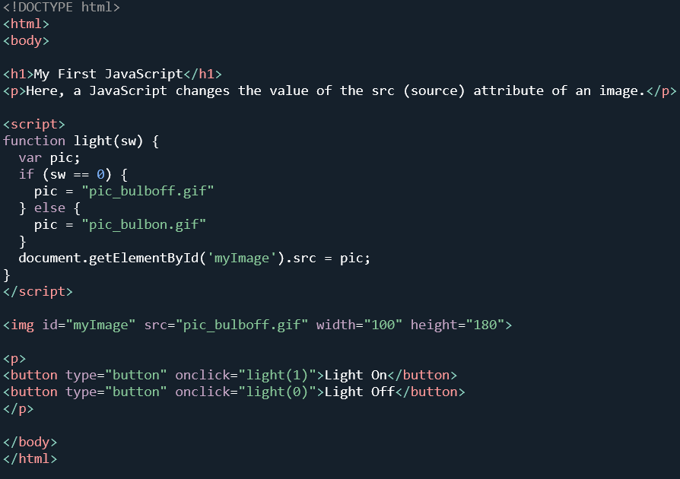
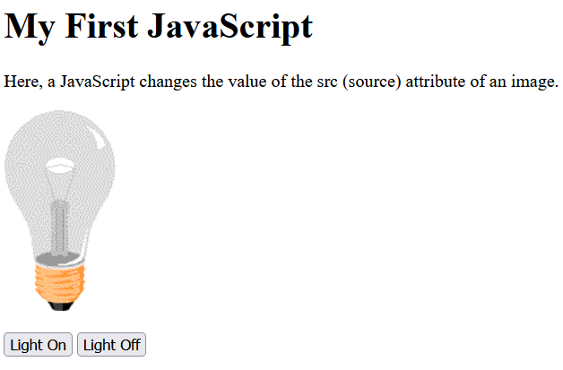
JavaScript Examples – Changing Attributes

Slide 22
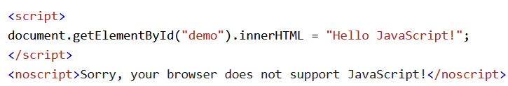
The <noscript> Element
All browsers have the option to disable JavaScript if you would like to
The <noscript> element is alternate content to display if a user’s browser does not support JavaScript

